Slide 1
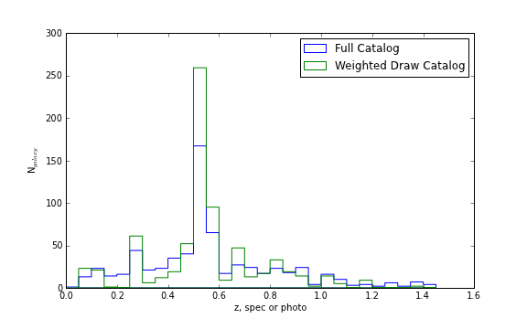
N_{galaxy}
Redshift (spectroscopic if available, otherwise photometric)

Slide 2
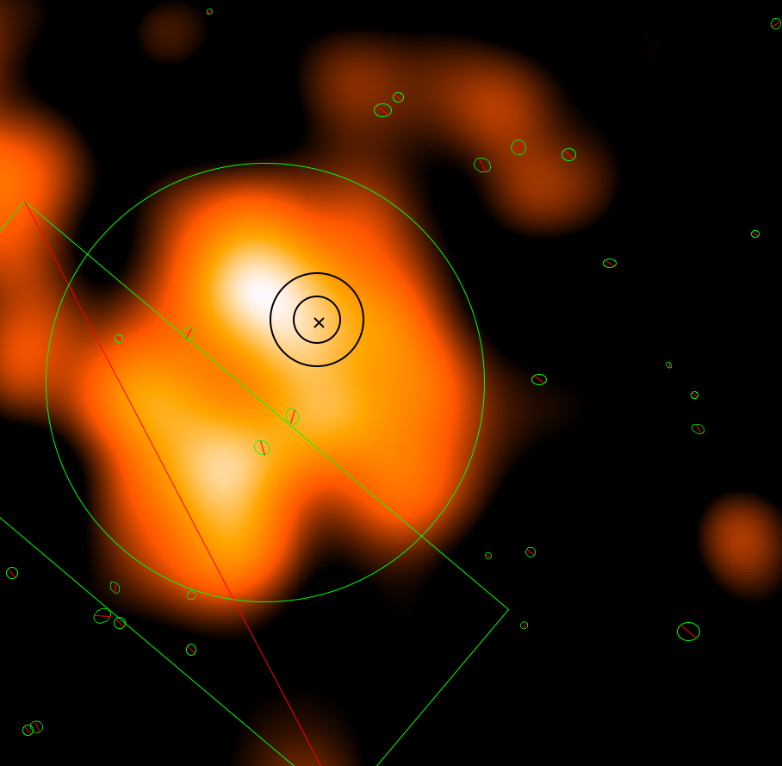
Gas centroid analysis region
X-ray centroid and confidence limits

Slide 3
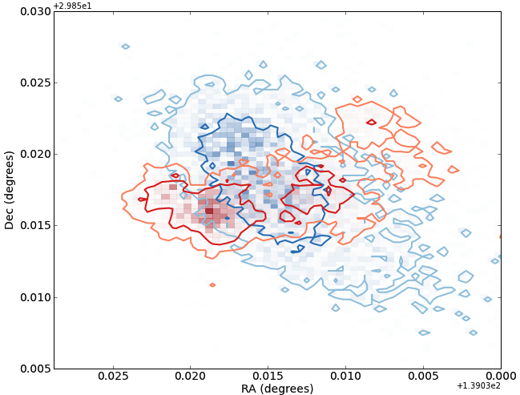
Merger Axis
Lensing
Centroid
Galaxy
Centroid
Northern Subcluster

Slide 4
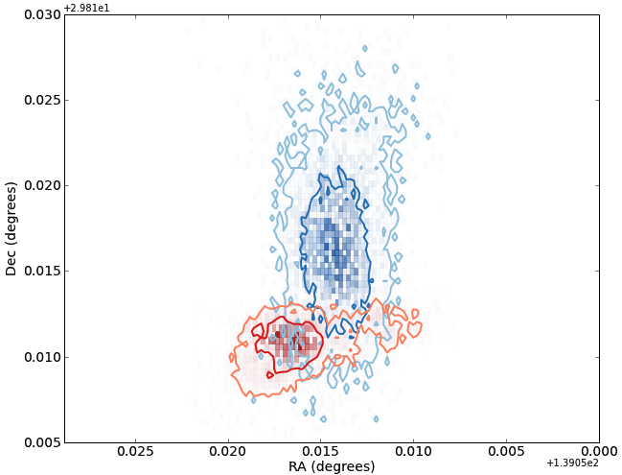
Merger Axis
1st Principle Component Axis
Lensing
Centroid
Galaxy
Centroid
Southern Subcluster

Slide 5
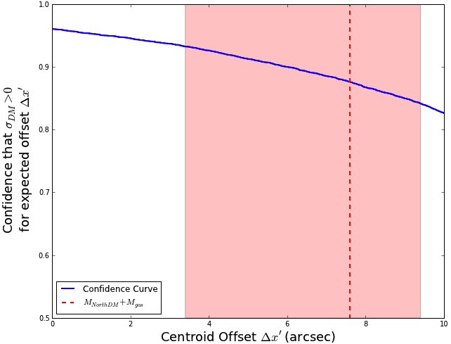
Southern
Subcluster

Slide 6
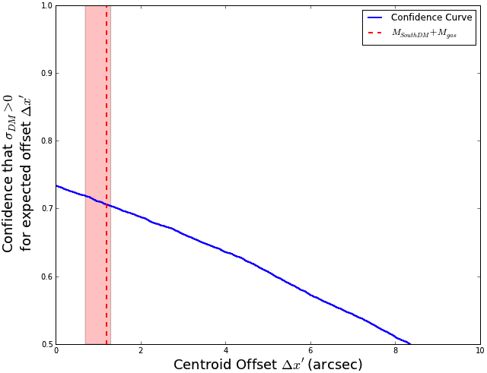
Northern
Subcluster

